Slide 1
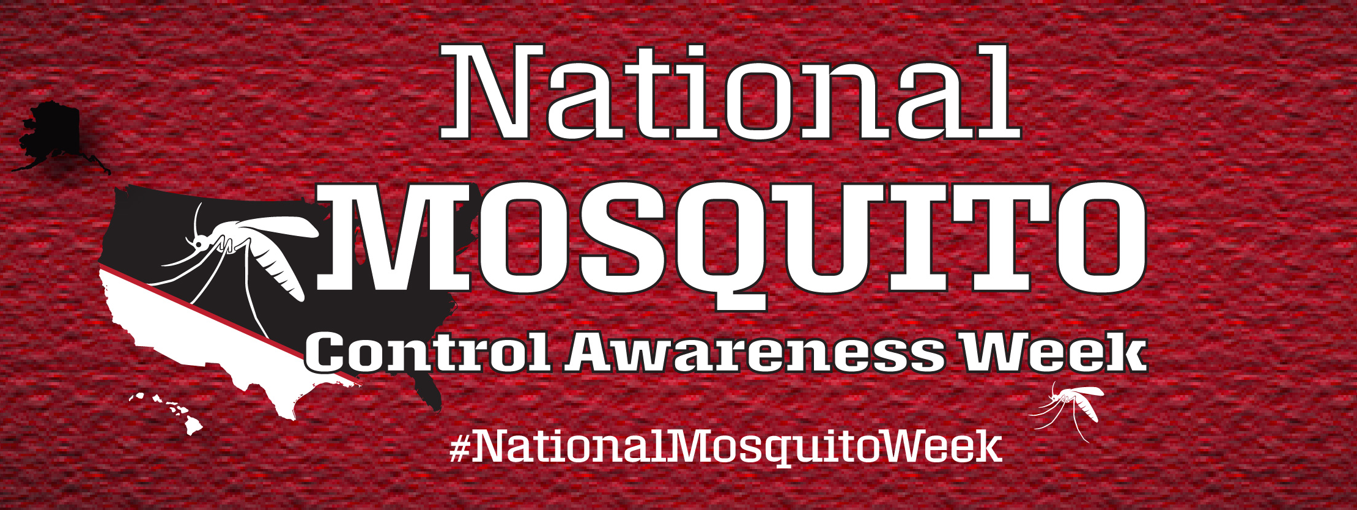
June 23-29, 2019 www.MosquitoAwareness.org

Slide 2
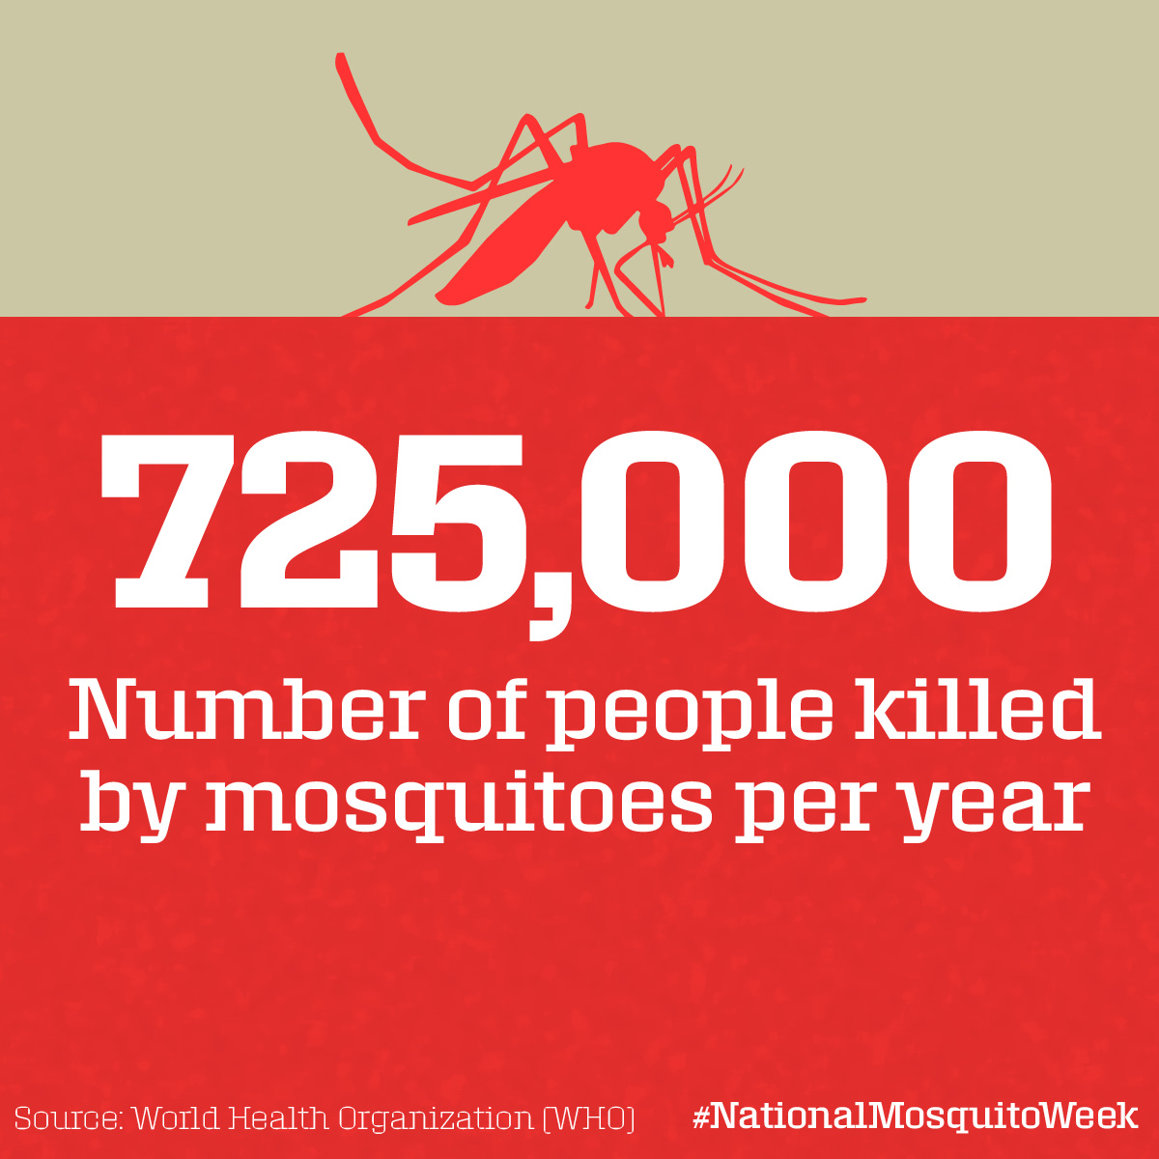
Did you know mosquitoes are the most dangerous creatures on the planet?

Slide 3
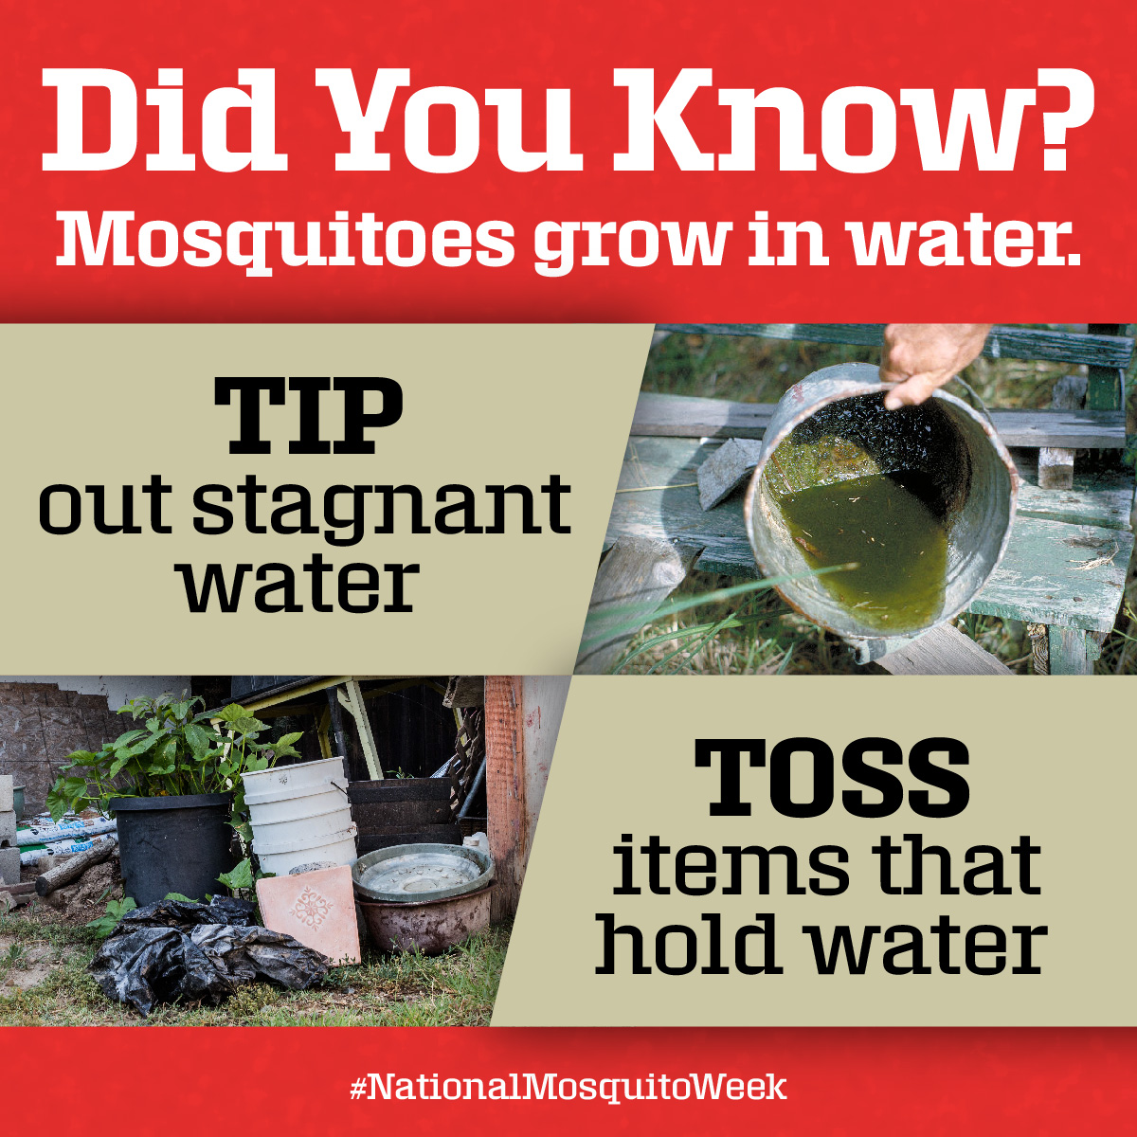
To stop mosquitoes from growing, eliminate stagnant water

Slide 4
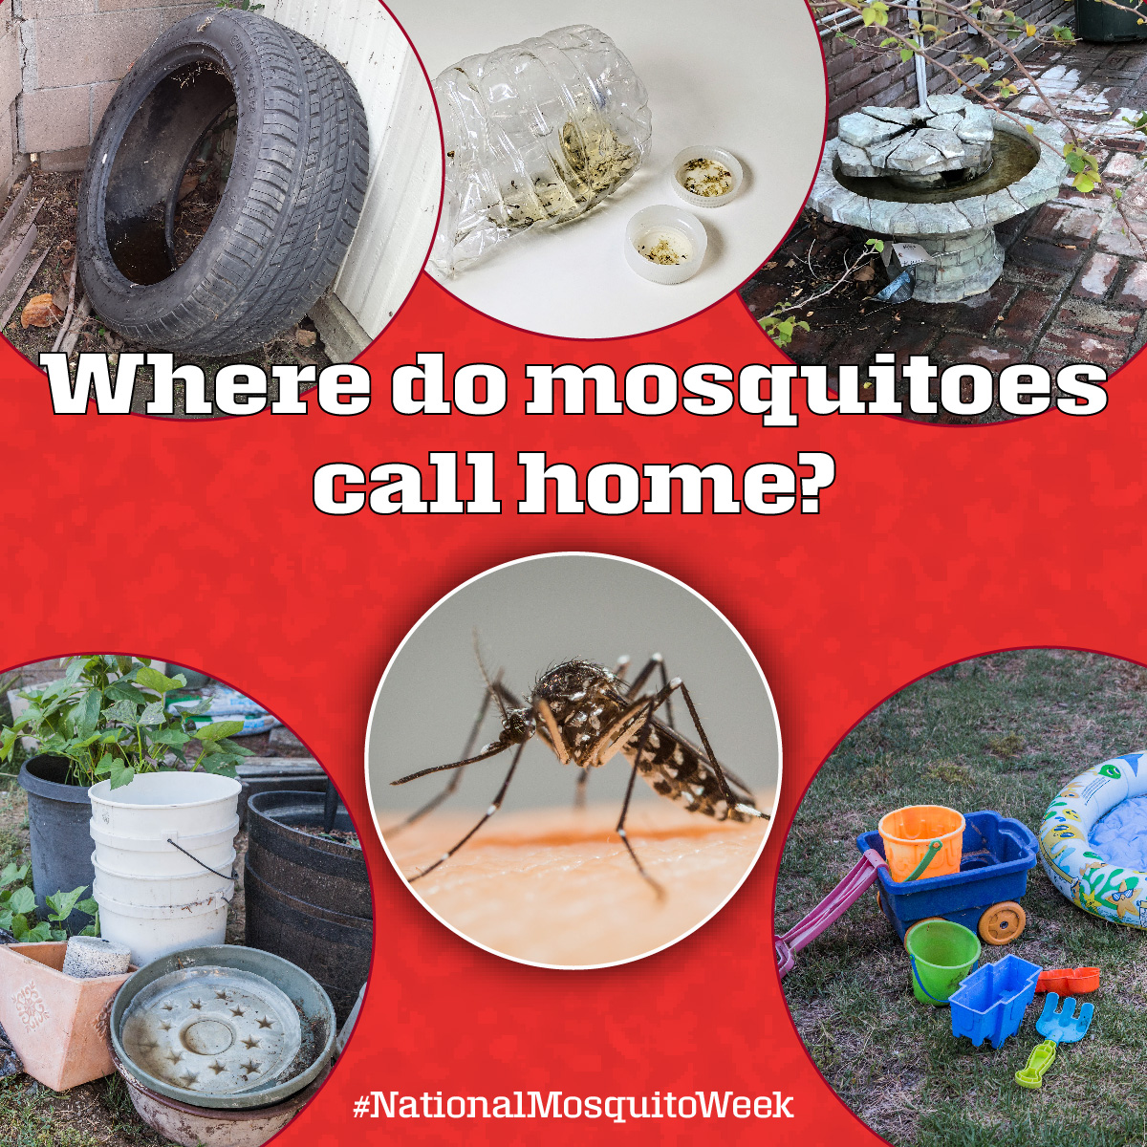
Stagnant water can be found in many places around the home

Slide 5
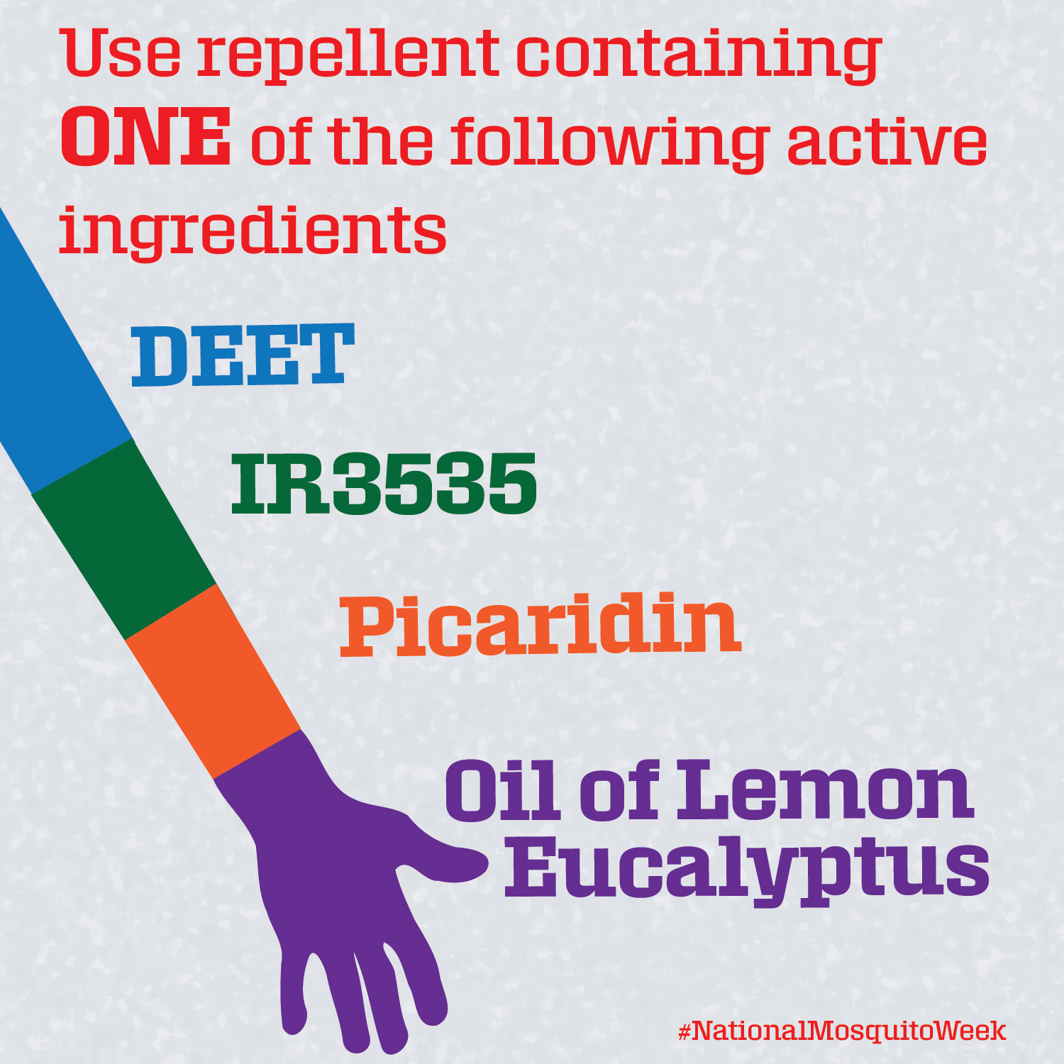
Be sure to use repellent!

Slide 6
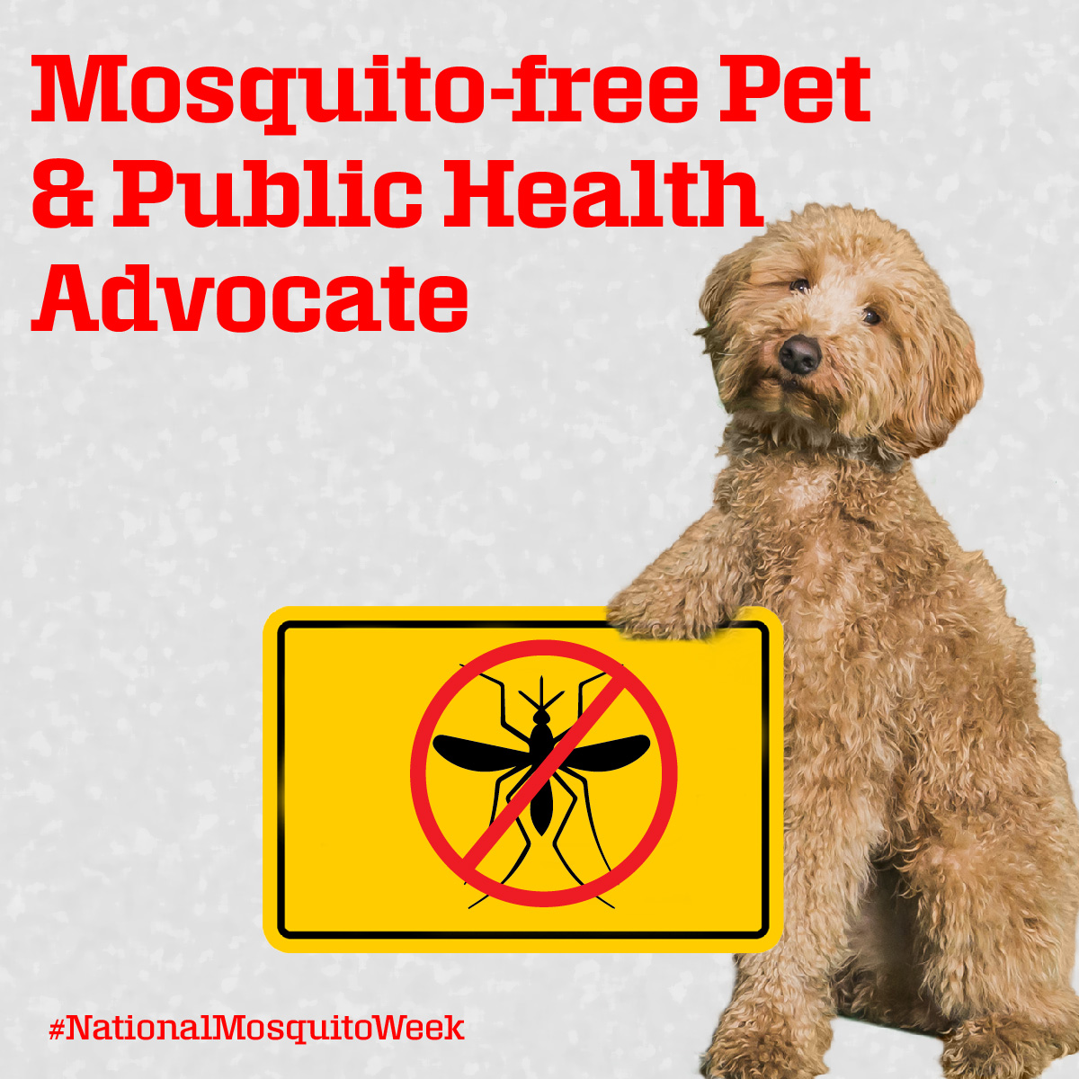
Dogs can get sick from mosquitoes, too!

Slide 7
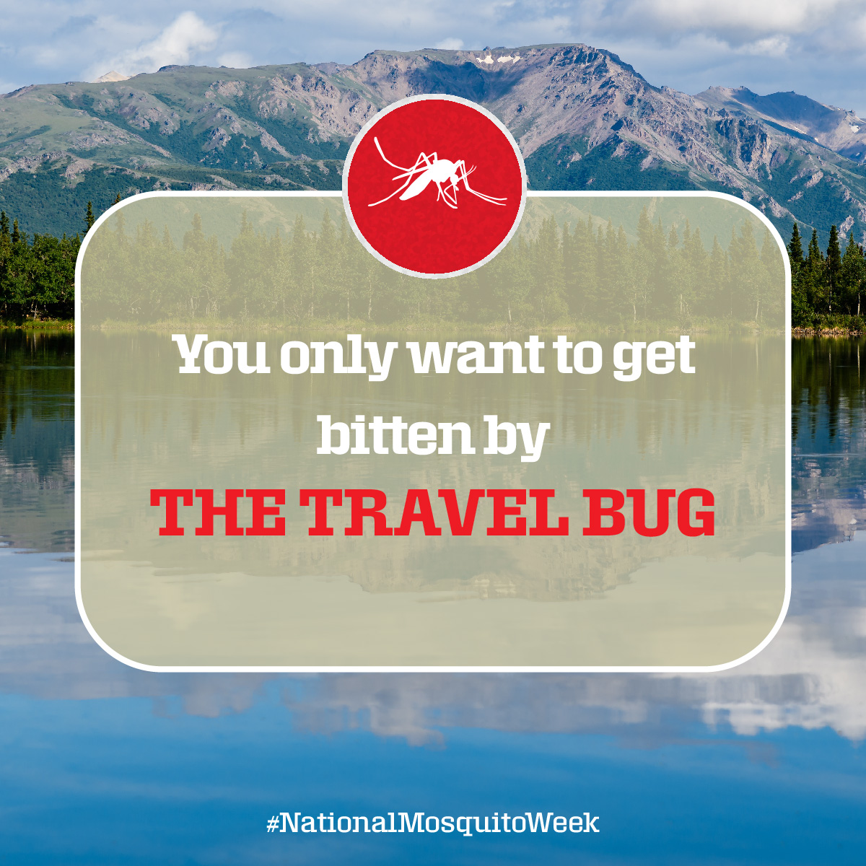
Don’t forget to use repellent
when you travel

Slide 8
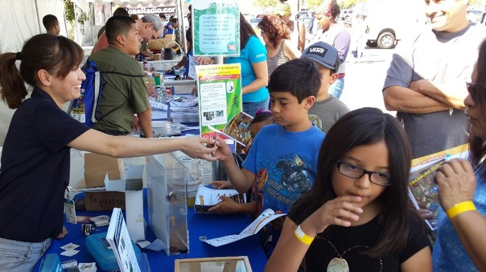
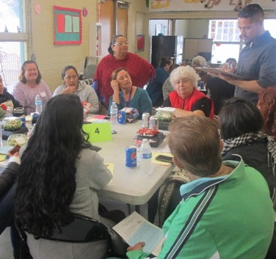
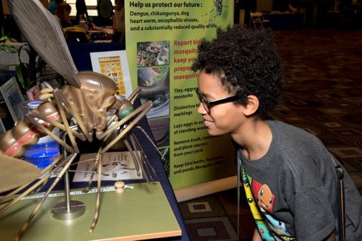

Thank you for doing your part
We cannot do it alone.
Mosquito control is a shared responsibility.
If Residents/Businesses Require Assistance:
www.SGVmosquito.org | 626-814-9466

